Slide 1
CAREER
CS4244: Senior Design
Instructor: Kunal Johar

Slide 2
Beginning your career

Slide 3
Choices Post undergrad…
Enter Society
Work
Community Service
Delay the Inevitable
Grad School
“Take a Year off and decide”

Slide 4
Grad School
Why now?
You will not want to go back to school once you start an income
It will be easy*
Why not now?
Specialized knowledge won’t help you solve problems you didn’t know existed
*Easy compared to enrolling later!

Slide 5
Community Service
Domestic Opportunities
Teach for America
Americorps
International Opportunities
Peace Corps
Teach English Abroad
http://www.grinnell.edu/offices/socialcommitment/postgradopps/browse

Slide 6
School vs Society
School
Educated Technical People
Non-technical people are also competent
Friends and Professors Want to See you succeed
Society
Thoughts?

Slide 7
Society is dumb
“How do you copy and paste?”

Slide 8
Society is lazy
“Can’t you just…”
“It would be easier if you just did it”
LMGTFY…

Slide 9
“Actors” in Society Use case
How do these compare to friends/professors?
Boss
Coworkers
Counter Parties

Slide 10
Structure in School
GPA
Homework: 50%
Attendance 10%
Exams / Papers: 40%
B/B+ = Do Homework + Come to Class
A = Study Hard
Know ½ way if you are doing badly and work with the professor to aim for that B

Slide 11
Unstructured School
What if…
School gave no structure
You built your own curriculum
You graded yourself
Where would you begin?
How far would you push yourself?

Slide 12
Structured Career
I worked at the Government
Automatic Guaranteed Promotions each year for 3 years
Good Pay
Friendly Environment
(I was not a threat to others)

Slide 13
Do you want a structured career?
I thought I did
Work for a few years
Maybe get an MBA
Have work pay for the MBA maybe?

Slide 14
dCareer dTime
This was the original title of my talk
OPTIMIZING YOUR CAREER

Slide 15
DOW: 6547.05 March 9, 2009
“I am so much luckier than my parents, I’ll never have to worry about money”

Slide 16
Structure didn’t exist
Promises Gone
Tuition reimbursement suspended
Multi-year pay freezes
Full Categories of Jobs Eliminated

Slide 17
Sequester enacted March 7, 2013
Why WOULD a smart person ever work for the government Again?

Slide 18
ECB Bailout TERMS
March 16, 2013: “In return for the bailout loans, Cyprus will impose a one-time tax on bank customers and their deposits” ….6 – 10% of your bank account, taken.
March 25: ECB Came to their senses

Slide 19
My career
Looking back on 7 years things were not AS I expected

Slide 20
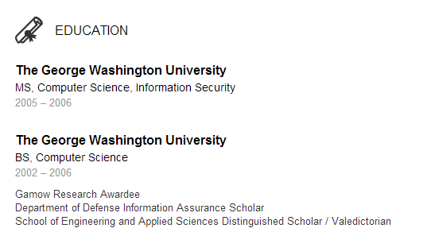

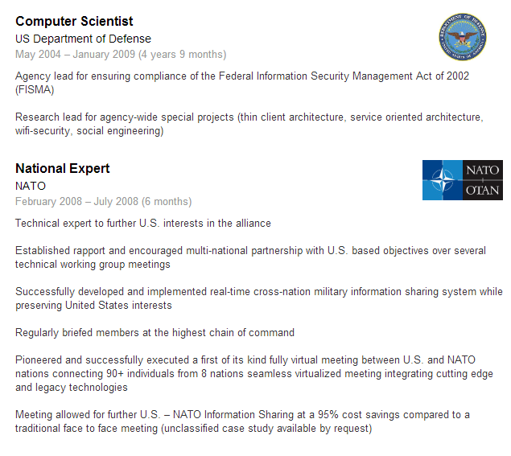
Kunal Johar
“That’s awesome! You have your own company!? What made you leave work”

Slide 21
Kunal Johar
NOBODY CARES

Slide 22
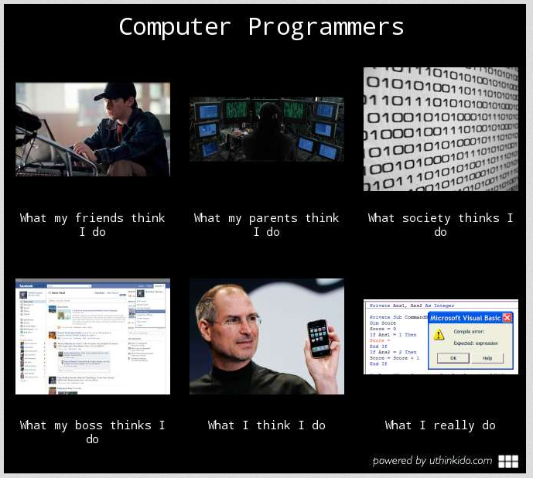
Perception > Reality This will be your First daunting Challenge.

Slide 23
How are We Perceived
“I just need a programmer”
http://www.cs.uni.edu/~wallingf/blog/archives/monthly/2010-12.html#e2010-12-01T15_45_40.htm
All IT is the Same
Software
Fixing Printers
Knowing how to use applications

Slide 24
How We Perceive
“It’s Just”
Sales
Marketing
Business
Management

Slide 25
The music school
5 years of hell that I was lucky to have.

Slide 26
“I just need a Developer”
We need a system to track attendance and bill people every 6-15 weeks.
People should only be able to skip 1 lesson every 6 weeks without penalty.

Slide 27
First Proposal
“One action (booking a student) will automatically keep track of billing, payroll, attendance tracking, and student progress”

Slide 28
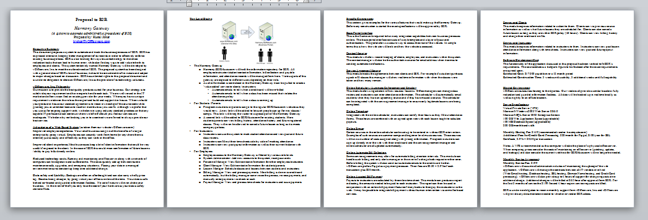
Proposed Functional Specifications
Now we call this “Free Consulting” – and make sure we never do any of it

Slide 29
Looking Back
What if I built what they asked for?
Why did I come up with this detailed proposal?

Slide 30
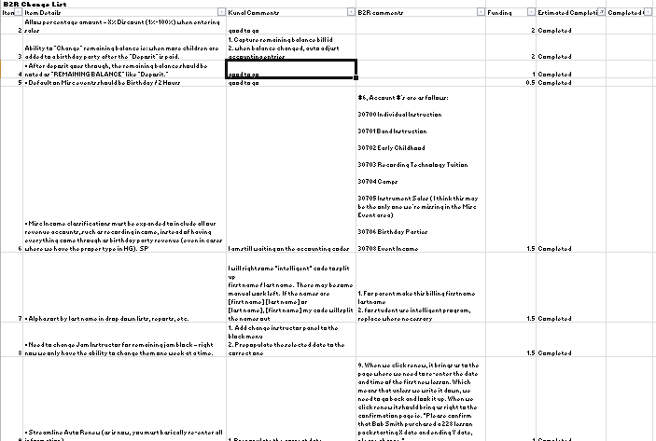
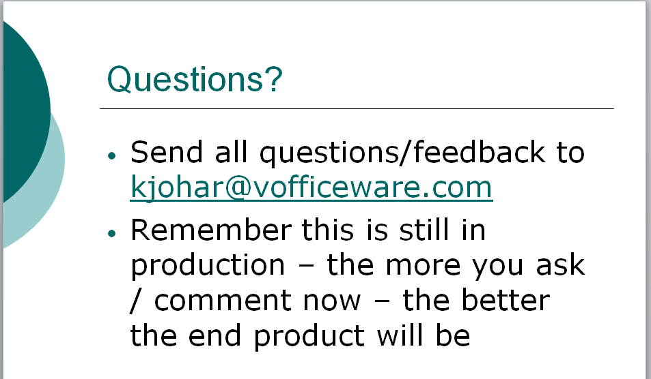
“Milestone #3”
“Few additions”
Lasted about 45 weeks
Just add this feature
DB Migration scripts?
Code repository?

Slide 31
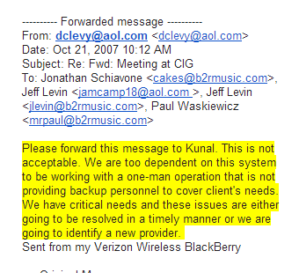
Deal with lots of BS
I was billing $35/hour at the time

Slide 32
Oct 2007 – BS Quota reached
If I quit, what would happen to my company?
If I quit, what would happen to their company?

Slide 33
Summer 2008
Govt job here was way too boring
Harmony Gateway now at now at 100 tables
Can’t / don’t want to do both

Slide 34
The Big Pitch
Naivety at an all time high

Slide 35
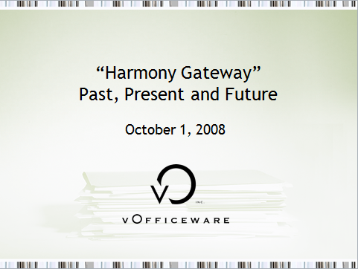
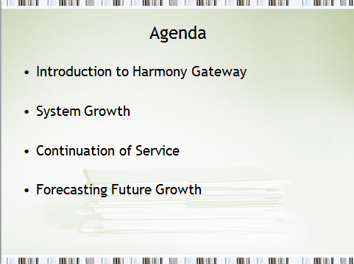
Presenting to C Levels

Slide 36
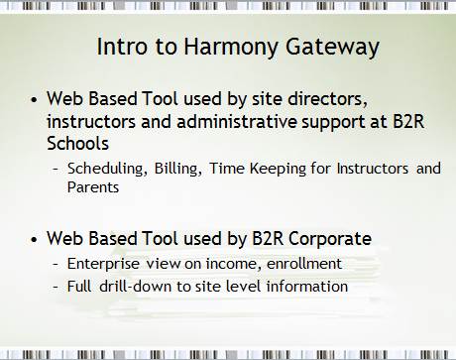
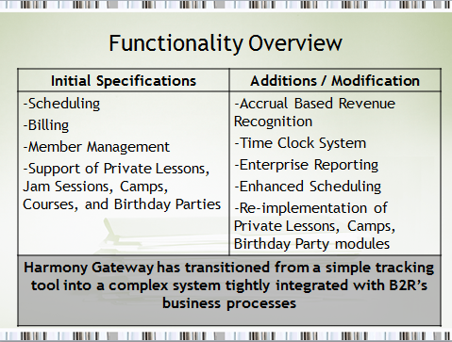
PRESENTING TO C LEVELS

Slide 37
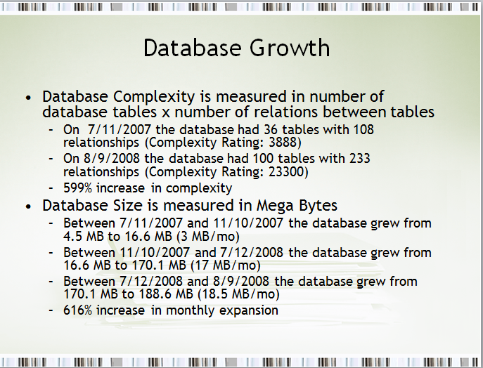
WHAT WE THINK IS IMPORTANT

Slide 38
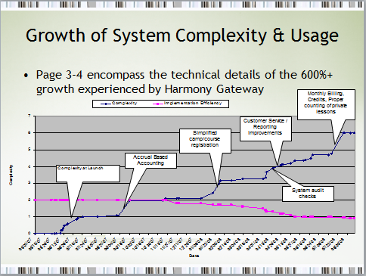
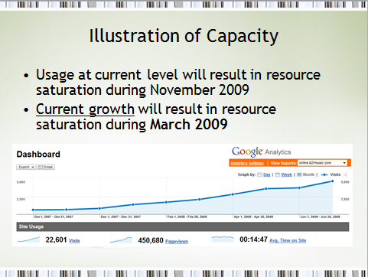
AS EXPLAINED TO C-LEVELS

Slide 39
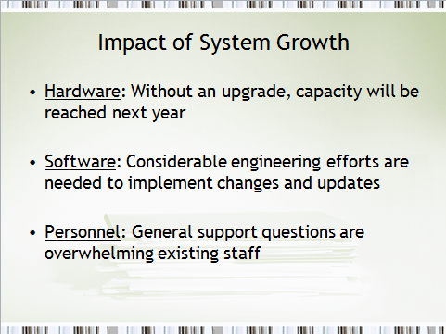
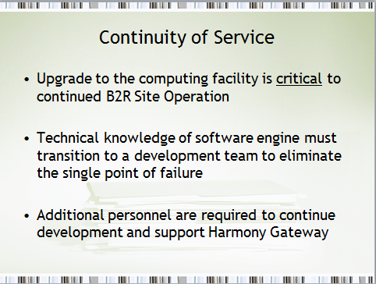
AS EXPLAINED TO C-LEVELS

Slide 40
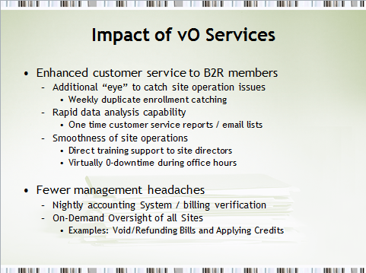
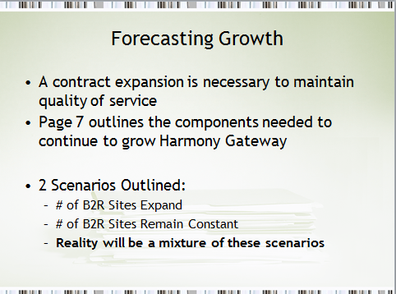
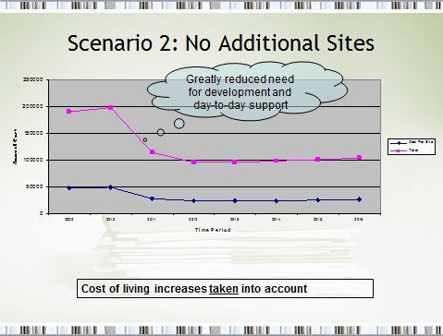
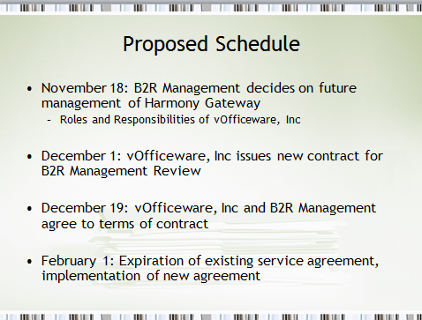
Structure / plans

Slide 41
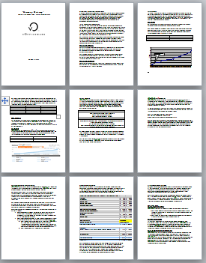
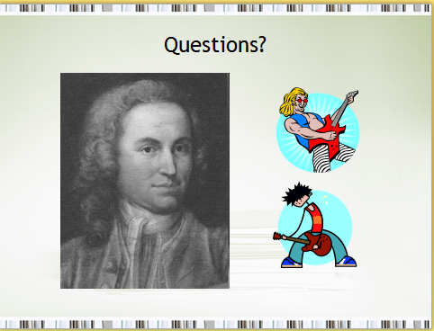
$190,000 please -- By the way you don’t have a choice

Slide 42
Career Phase I
“I heard you teach Kunal, where will you find the time to work on this system”
People will push you to your limits…LET THEM!

Slide 43
The deal
$82, 819
They will handle IT
I will handle software dev
“1110 hours of dev/support”
They stalled until Dec 28th

Slide 44
Looking Back
I thought Senior Management is a bunch of idiots
Ready to dismantle a system without knowing anything about how important it is
Turns out it was on purpose
You’ll see it when you go car shopping
Undermining, insulting, frustrating to get bottom dollar

Slide 45
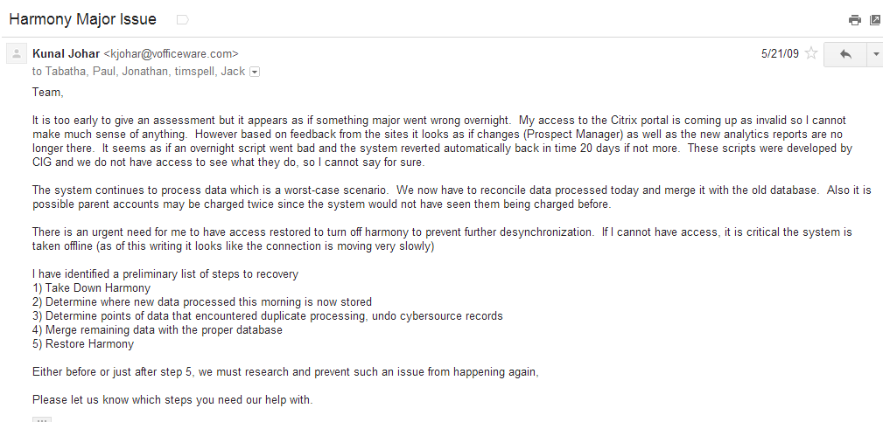
7 weeks after “hosting” Transferred to them
26 emails just after landing in Houston Airport

Slide 46
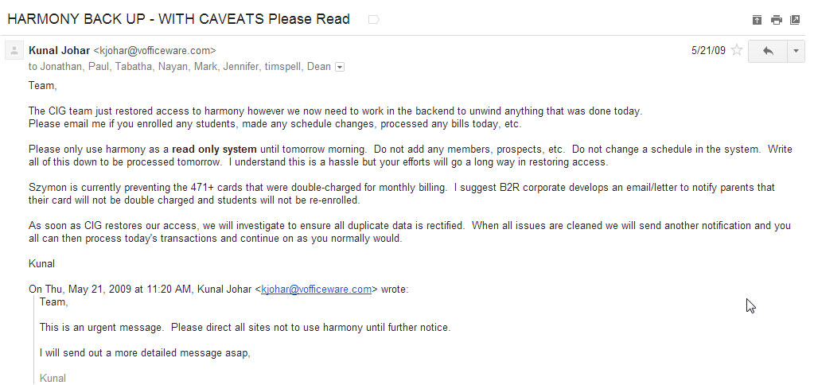
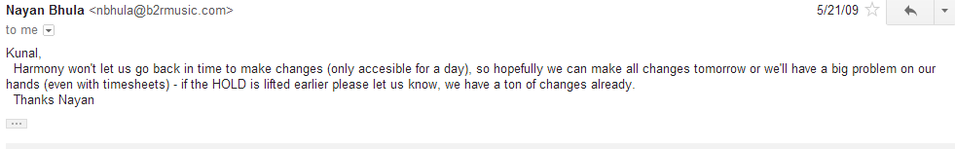
Command and Control

Slide 47

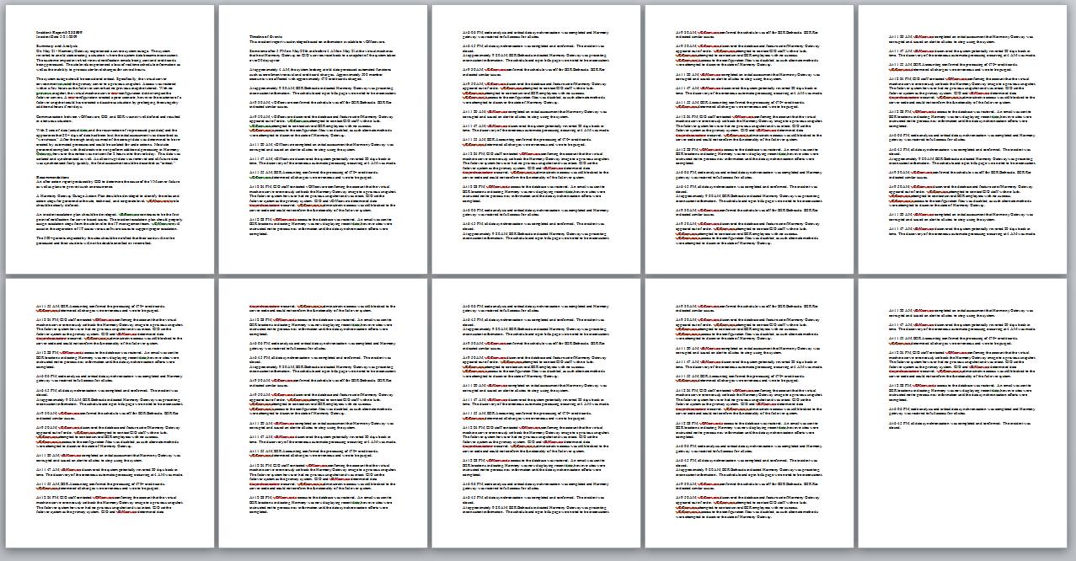
Yea no one read This Either

Slide 48
What happened?
VM Went into Auto Recovery Mode
Database had day month old data
Web server ran auto-renew process on 600 customers

Slide 49

Road Blocks are to be Expected
Same time as music school deal
$90k
Great money, great cause

Slide 50
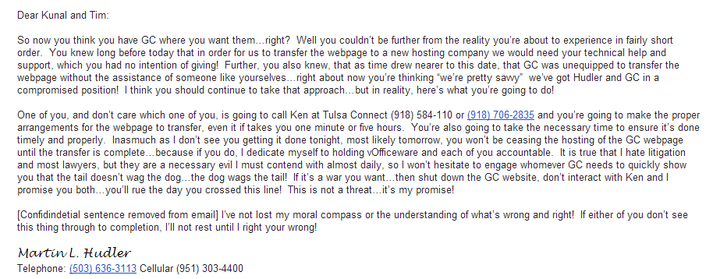
Total Money Received: $4,200

Slide 51
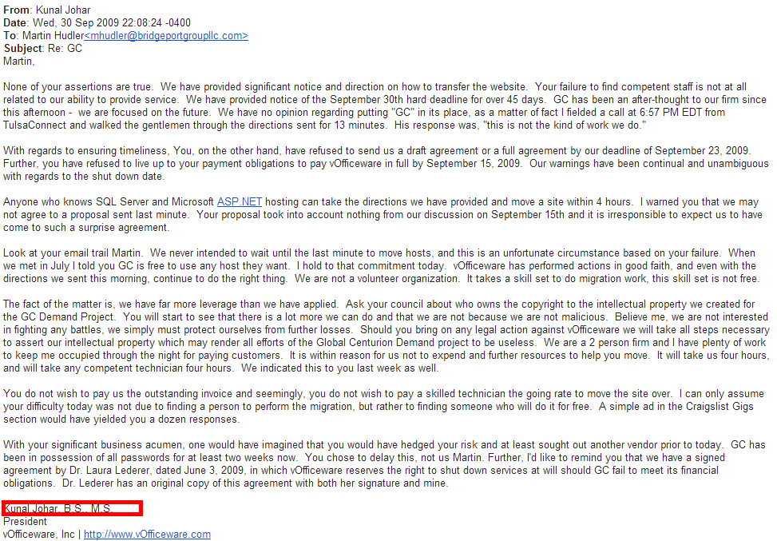
BS, MS

Slide 52
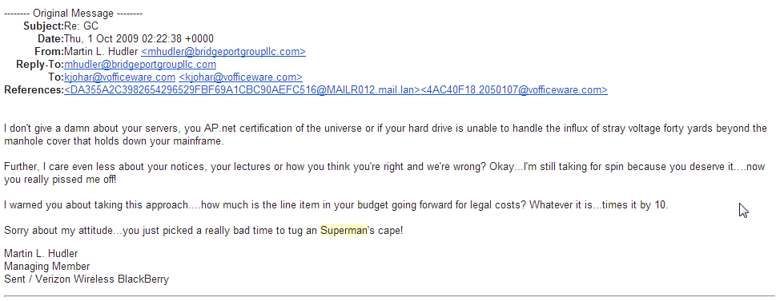
Superman Part I

Slide 53
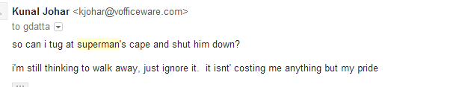
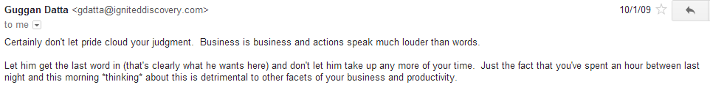
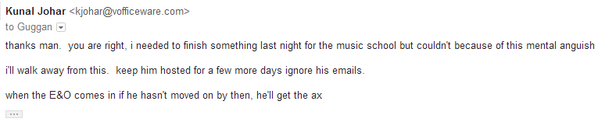
That was fun but who had more to lose?

Slide 54
Jay Park
Music School “just needed a programmer”
Society does bad things in desperation
March 2009
Kunal needs income
Jay has wife + kids

Slide 55
Perception
What was Music School Thinking?
What was Kunal thinking?
What was Jay thinking?

Slide 56
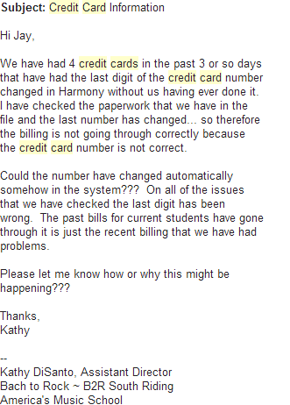
The Modulo Method
I never make mistakes
I only had AMEX and thought credit cards were 15 digits
One script and 10 seconds later, all credit cards lost their last digit

Slide 57
The Modulo Method
What would you do?
Restore from backup?
What about impact from looking bad vs Jay?

Slide 58
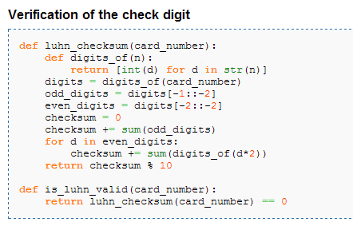

Luhn Algorithm
Given N-1 digits, compute Nth digit as check digit

Slide 59
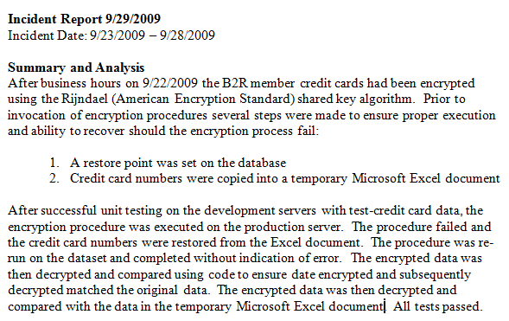
Fair is Fair

Slide 60
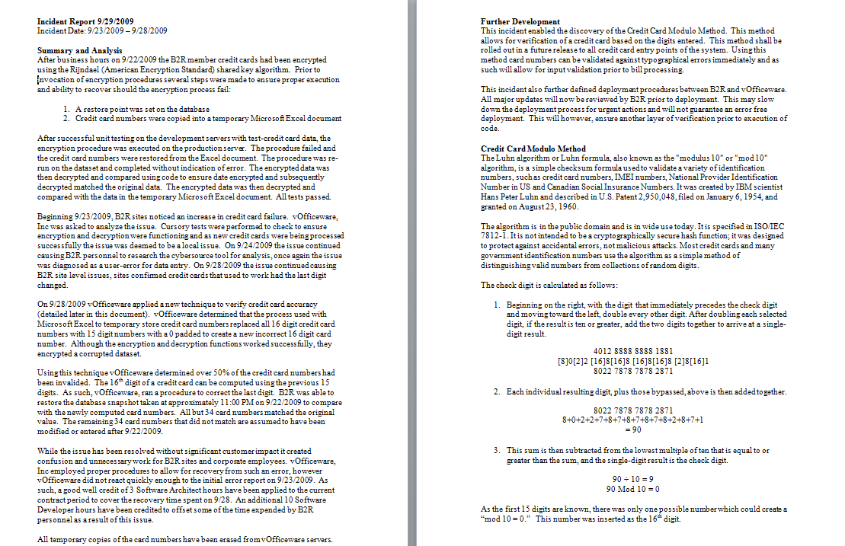
Full Report no one read

Slide 61
Superman IV
What was the premise of Superman IV (and Office Space)?
You guys too young for this?

Slide 62
Superman IV
June 2010
Moved Accounting system from “cash” to “accrual”
Moved accounting system from “single entry” to “double entry”
“What could go wrong”

Slide 63
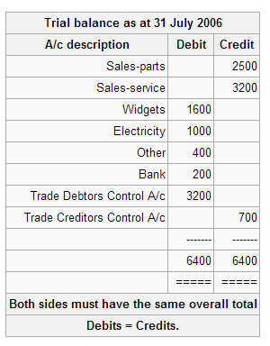
Double Entry accounting
All transactions must be balanced
Depending on account code, debit or credit can be + or – action

Slide 64
Superman IV
$70,000 mistake
I had created discounts as credits instead of debits
Thus I double counted the impact!

Slide 65
Out of balance
Accounts must always balance
I had never been more nervous (because I lost control of my own system)
I could not explain how my system worked
Others’ confidence in me plummeted
Self confidence plummeted

Slide 66
Bank in Error your Favor
Turns out $70k mistake was in favor of the schools
I was off the hook
I learned a bit more accounting and cleaned up the system

Slide 67
Wedding in Serbia
One month after rewriting the accounting system….
Also was asked to rewrite the way report cards were generated
“What could go wrong”

Slide 68
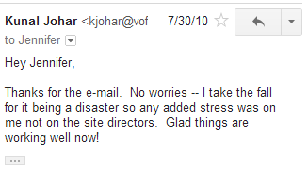
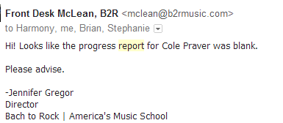
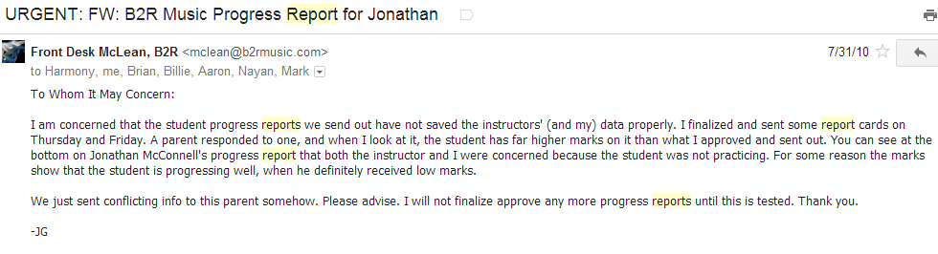
“I AM A RELIABLE PERSON”
I deployed new changes 10 hours later, just before getting on my flight.

Slide 69
Frankfurt Airport
30 euro for a wifi pass
Tired out of my mind
1 hour layover to “Fix issues”

Slide 70
The Wedding
Can you imagine not drinking at a Serbian wedding!?
Was at Internet café all morning before wedding
Was at internet café all morning after wedding

Slide 71
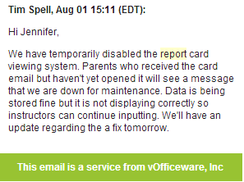
I Failed Hard

Slide 72
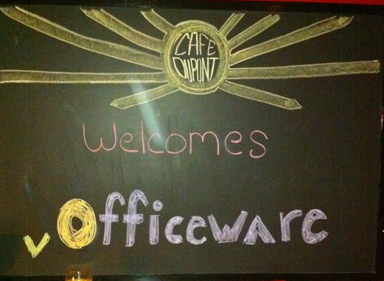
Melt Down Ensues
Regularly working 300h/month
Hating life
Becoming socially awkward

Slide 73
Career Phase II
I needed someone to tell me this kind of shit at some point in my life. Don't confuse feelings of excitement about a great year, celebration of your hard work, and achieving success while constantly facing risk with making a few bad jokes at a holiday party. All of this shit you're feeling is very necessary and the part of the life we hate to call growing up, so keep doing what you're doing and just remember it next time you're in a similar situation. the people you'll find that you admire the most aren't the ones that set world records in money-making or fitness, it's the ones that have figured out the biggest challenge of all--increasing livelihood in all 'buckets' of your life while maintaining a healthy balance. just keep up the energy level, but spread it out and continue the cycle of making mistakes / learning from them... you'll be surprised how many people will grow to respect your attitude and accomplishments regardless of outcome.
People will push you to your limits…TAKE CONTROL!

Slide 74
$454,000
“95% of that was all you man”

Slide 75




Reset, Refocus, and Refine
Do not chase shiny objects
“Pareto Principal” 80/20 Rule

Slide 76


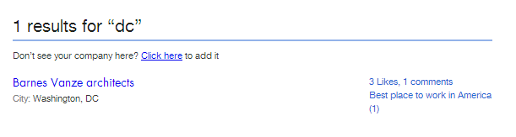
Follow the money
$300 out of $454 went towards vendors who I needed to ‘bail out’
….for clients who have terrible business models

Slide 77
“My Hourly Rate”
Early in your career don’t worry about it!
OUT OF BUSINESS

Slide 78
Re-Assess Oct 2008 Decision
How is the music school doing?
It’s now 2011. They are growing and want to franchise
How am I doing?
I’m exhausted, generating a lot of revenue, seeing little reward for myself

Slide 79
“Nothing is Easy”
Good workers are hard to find
My ‘best of the best’ developers are quitting every 6 months
My inexpensive developers never learn, I need to retrain every 3 months

Slide 80
Scalpel
“Hey Kunal, budget is tight, we are looking for 10% cuts across the board from all of our vendors”
I just hired Zack, started investing in him to take over my responsibilities, now they can cut me on a whim?

Slide 81
Re-ASSESS Again and Again
What if they cut me?
What if I cut them?
Who has more to lose?

Slide 82
Music School Operations
$220,000
How much does a senior developer make?
How about 2?
How much does it cost to run a help desk?
How important is this system to them?

Slide 83

Perception: Music School’s Business
What are they in the business of?

Slide 84
“What if”
What if in 2008, I got my 200k contract?
Would they have kept paying?
When they fired Jay park, why didn’t they look for another developer?

Slide 85
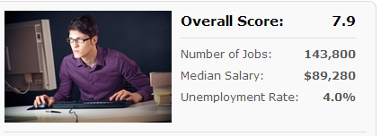
Short Sightedness
Perception:
vOfficeware is a tiny company that needs our business to survive
We can drop him at a whim so they need to go above and beyond for us
Reality

Slide 86
Career Phase IIi
Opportunity does not exist but you can create it
Now you are in control, Don’t Forget about perception

Slide 87
Wait for the moment
Build maximum leverage
Franchising agreements mean they have commitments to people with bigger pockets than me
I’ve masked the fact that I have 3 developers + me working on the system
Next time the scalpel comes, I’ll be in control

Slide 88



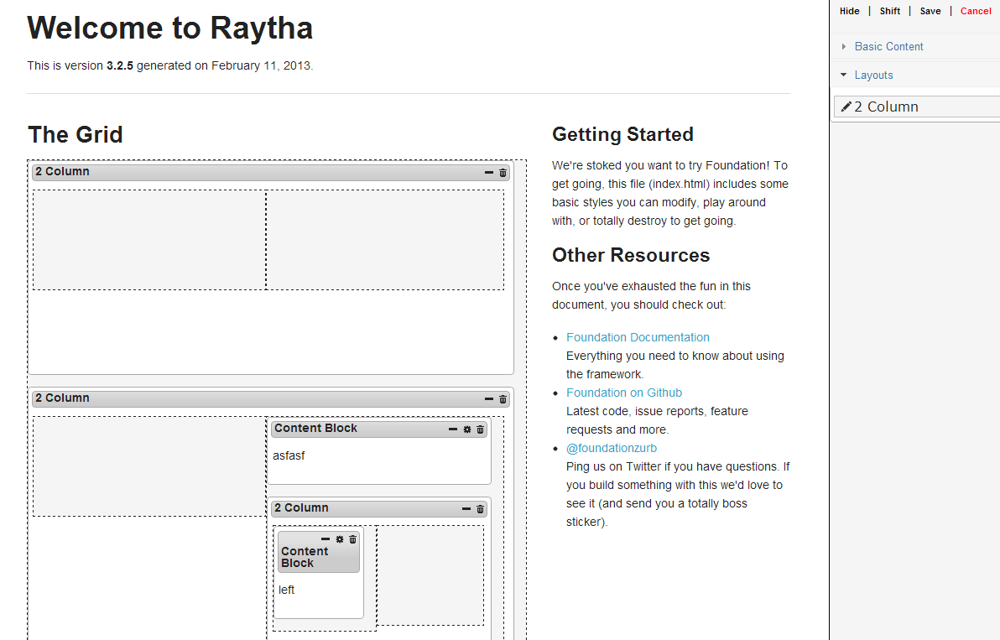
Now What?

Slide 89
Your Career
Your current aspirations are probably false

Slide 90
You will succeed
Computer Science = $$
Unregulated profession
Software runs the world, shortage of developers, let alone good developers
DC market has ‘body shops’ paying $100k after a few years of working
Top students can get this now

Slide 91
Post School Plan
Try a lot of things
Determine what you hate
Maybe you’ll find something you want
Work hard in all facets and don’t worry about over working or being underpaid – as long as it is short term

Slide 92
Remember perception
What am I?
What do I expect from me?
What do others expect from me?
What do I expect from others?

Slide 93
Remember Structure
Do you have a plan for now?
Do you have a plan for tomorrow?
Do you have a backup plan?

Slide 94
Find and Fight the demons
There will always be some force condemning your success
Money you earn is less money for someone else
People want to maximize their own keep
Understand how they perceive you, work within that perception to make yourself invaluable
Now you are in control of your own career!

Slide 95
But How?
How can I be unbelievably valuable?
Ask tons of questions
Find out the work no one else wants to do
Take things off your boss’s plate
People are lazy and will become addicted to your work ethic
They will forget how to work without you

Slide 96

10,000 Hour Rule Revisited
In our first class we discussed how it takes 10,000 hours to master a technique.
Your career is no different.
Don’t be short sighted
Recognize other’s perceptions
Succeed ☺

Slide 97
Thank you Very much
It’s been tremendous learning with ALL YOU THESE LAST FEW YEARS

